Slide 1
Year 2 School Trip- Places of Worship.

Slide 2
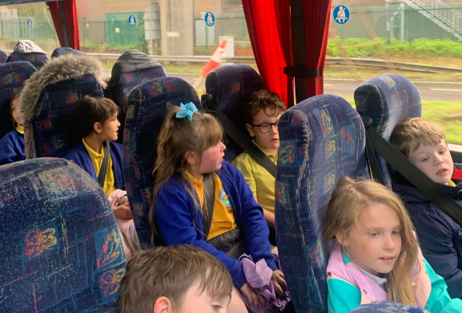
First……. because………..
Where? When? Who? Why? What?

Slide 3
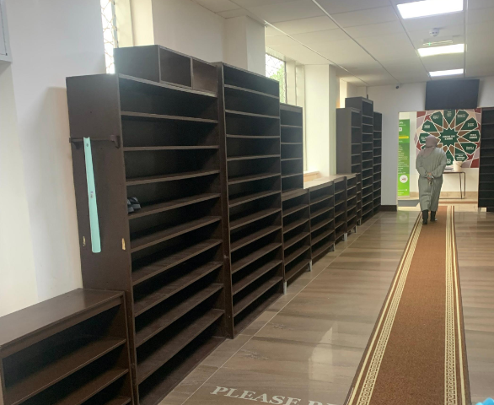
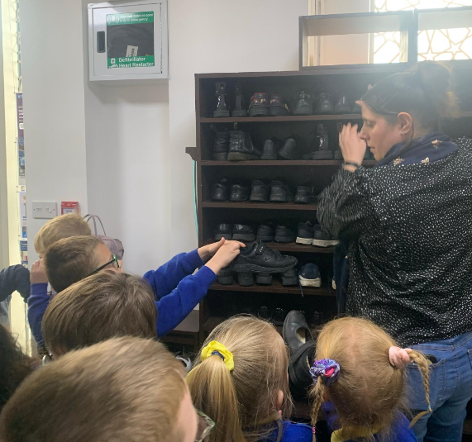
Then…. When…..If…….. wouldn’t

Slide 4
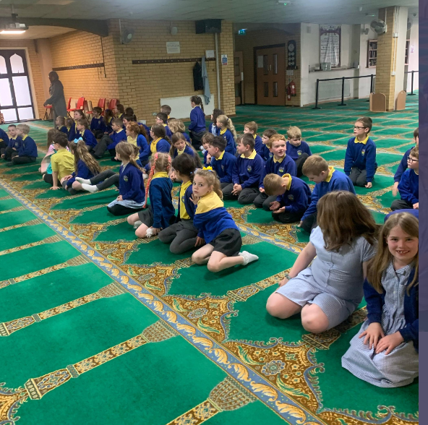
Next….. After that….. Soon…..

Slide 5
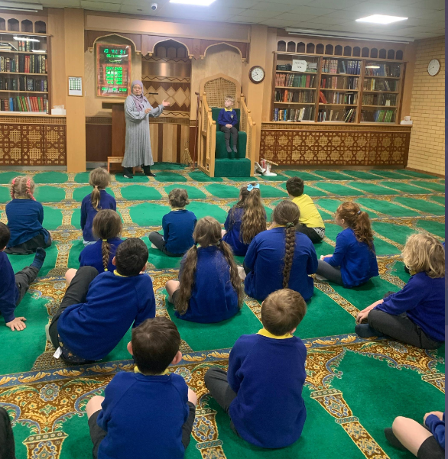

Slide 6
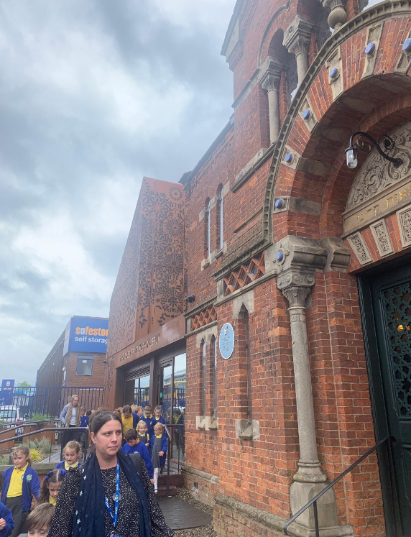
Later……
Soon after….

Slide 7
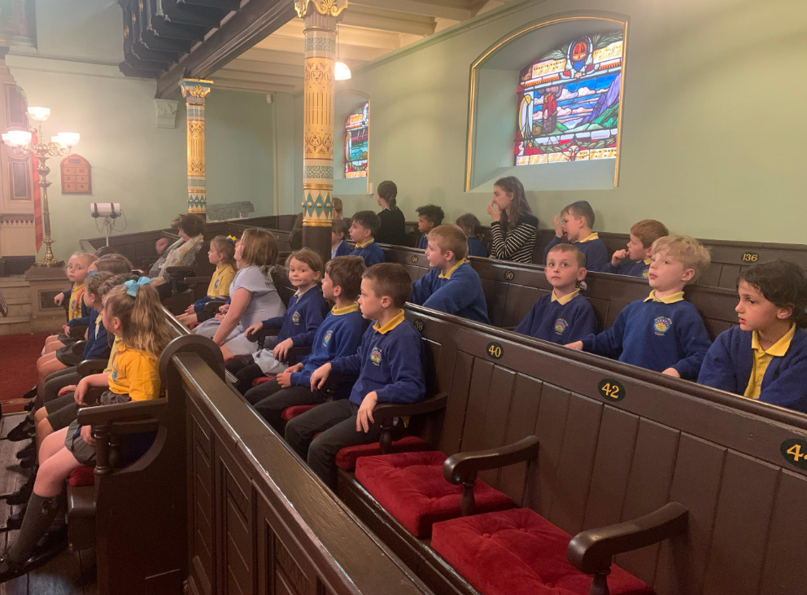

Slide 8
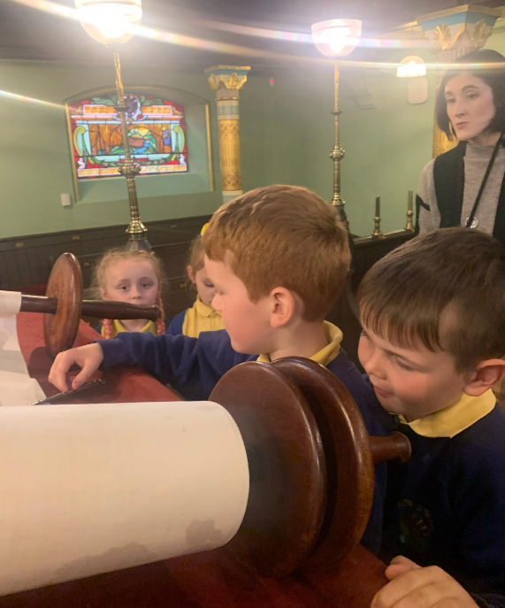

Slide 9
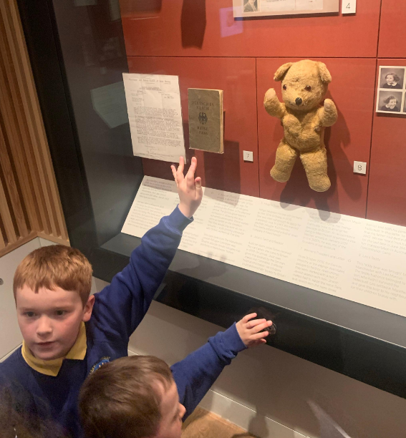

Slide 10
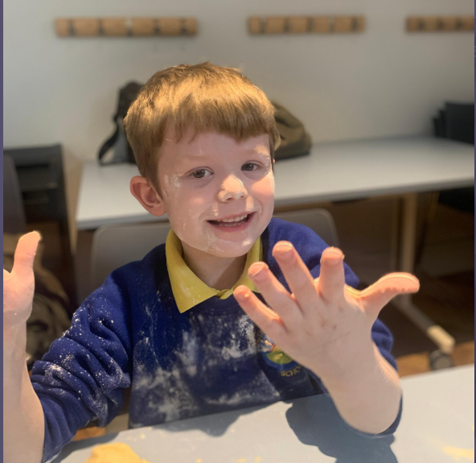

Slide 11


